Slide 1
Geometry
Agenda
1. ENTRANCE
2. Go over Practice
3. Review with CPS/Activity
4. 6-2 Properties of Parallelograms
5. 6-3 Proving that a Quadrilateral is a Parallelogram
6. EXIT

Slide 2
Practice WB 5-5 Review with CPS/Activity

Slide 3
Chapter 6
6-2 Properties of Parallelograms
6-3 Proving That a Quadrilateral is a Parallelogram

Slide 4
Handout

Slide 5
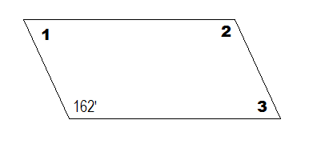
Example #1
Find the measures of each angle.

Slide 6
Example #2
Find the value of x.

Slide 7
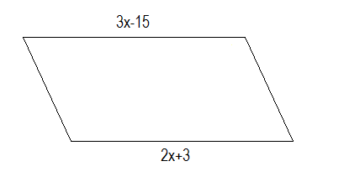
Example #3
Find the value of x.

Slide 8
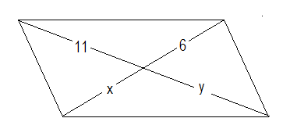
Example #4
Find the value of x and y.

Slide 9
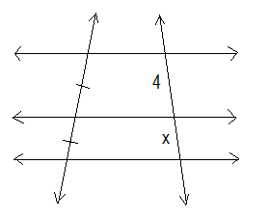
Example #5
Find the value of x.

Slide 10
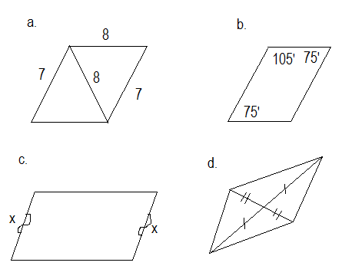
Example #6
Are these parallelograms?

Slide 11
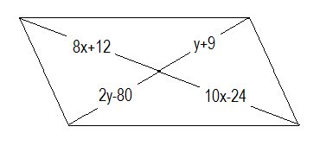
Example #7
Find the value of x and y to make the quadrilateral a parallelogram.

Slide 12
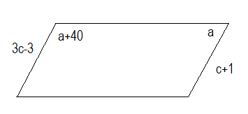
Example #8
Find the value of a and c to make the quadrilateral a parallelogram.

Slide 13
Practice
WB 6-2 # 1-6, 13-18
WB 6-3 # 7, 8, 10, 13-20
EXIT

